Slide 1
Effective De-escalation: Behavior Management Techniques
Be Calm | Be Confident | Be Cool
Stephen Goins, M.A., QMHP
Director of Transitional Progarms

Slide 2
Goals of this Information:
Learn how to approach an upset or disgruntled person(s) in a safe and trauma informed manner.
Learn tactics that are non-physical skills, which are helpful in managing aggressive behavior and prevent a potentially dangerous situation from escalating.
Empower you to handle difficult situations.

Slide 3
The Approach
Stop | Look | Listen | Relax

Slide 4
What is De-escalation?
De-escalation is aimed at calmly communicating with an agitated client in order to understand, manage and resolve their concerns.
Ultimately, these actions should help reduce the client’s agitation and potential for future aggression or issues.
Without specialized training, we should never consider the use of physical force.

Slide 5
Key Concepts to Keep in Mind
De-escalation techniques are ABNORMAL; we are driven to freeze, fight or flee when scared. However, in de-escalation, we can do none of these.
Reasoning with an enraged person is NOT possible.
The FIRST and MOST IMPORTANT objective is to reduce the level of agitation so that discussion becomes possible.
Remember to approach each situation with a Trauma Informed mindset.

Slide 6
De-escalation Tactics
Some Tactics are:
Simply listening
Distracting the other person
Re-focusing the other person on something positive
Changing the subject
Motivating the other person
Empathizing with the other person
Giving choices
Setting limits

Slide 7
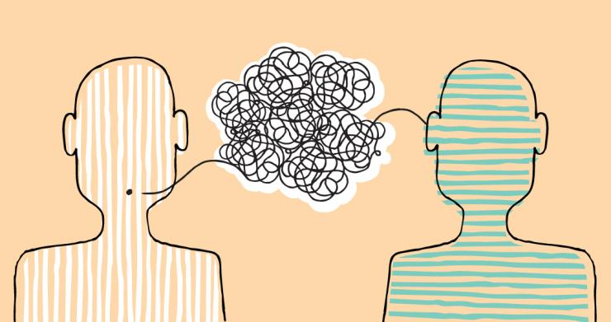
De-escalating Effectively
To verbally de-escalate another person, you must open as many clear lines of communication as possible.
Both you and the other person must listen to each other and have no barriers.
Barriers to Communication are the things that keep the meaning of what is being said from being heard. Common Communication Barriers include:
Pre-judging
Not Listening
Criticizing
Name-calling
Engaging in power struggles
Ordering
Threatening
Minimizing
Arguing

Slide 8
Keeping Situations From Escalating
Take a deep breath… It will help you calm down.
Focus on appearing calm, centered and self-assured even if you don’t feel it. Signs of anxiety can make the client feel anxious and unsafe, which can escalate aggression.
Use a calm, low monotonous tone of voice (normal tendency is to have a high-pitched, tight voice when scared)
If you have time, remove necktie, scarf, hanging jewelry, religious or political symbols before you see the client (not in front of him/her).

Slide 9
Ask for Help!
Alert someone else as soon as possible. (No help will arrive until someone else knows your situation).
Two heads are always better than one.
There is safety in numbers.
It will be beneficial to have a witness, if the situation deteriorates and someone is injured.

Slide 10
Listening
Three Main Listening Skills:
Attending: Giving your physical (and mental) attention to another person.
Following: Making sure you are engaged by using eye contact. Use un-intrusive gestures (such as nodding of your head, saying okay or asking infrequent questions.)
Reflecting: Paraphrasing and reflecting, using the feelings of the other person (Empathy).
Listen when you are “listening.”
No other activities when listening.
Multi-tasking is not good when you are listening.

Slide 11
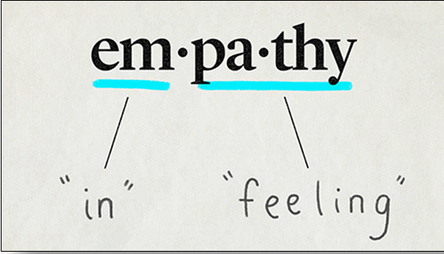
Be an Empathetic Listener
Do NOT be judgmental.
Do NOT ignore the person or pretend to be paying attention.
Listen to what the person is really saying:
Re-state the message.
Clarify the message.
Repeat the message.
Be empathetic!
Validate – “I understand why…”
Goal: to establish rapport with the other person.

Slide 12
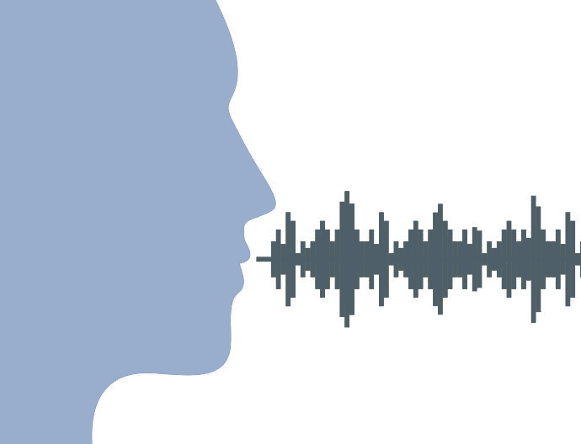
Use of Your Voice
Tone
Volume
Rate of Speech
Inflection of voice

Slide 13
Tone of Your Voice
A lowered voice level may set a tone of anger which could create fear or challenges.
A raised voice may set a tone of anticipation or uncertainty which may promote excitement or disruption.
Speak slowly – This is usually interpreted as soothing.
A controlled voice is one of calm and firmness which promotes confidence in both parties.
Humor may unintentionally offend someone and escalate the situation.
Always be respectful to the other person.
Using “please” and “thank you” or “Mr” or “Ms” indicates respect.

Slide 14
“Inflection of Voice” Examples:
What do these words mean?
“I didn’t say that you were stupid.”
“I didn’t say that you were stupid.”
(Your brother said it!)
“I didn’t say that you were stupid.”
(But I did write it on the bulletin board!)
“I didn’t say that you were stupid.”
(I said your brother was stupid)
I didn’t say that you were stupid.
(I said you were a complete idiot)

Slide 15
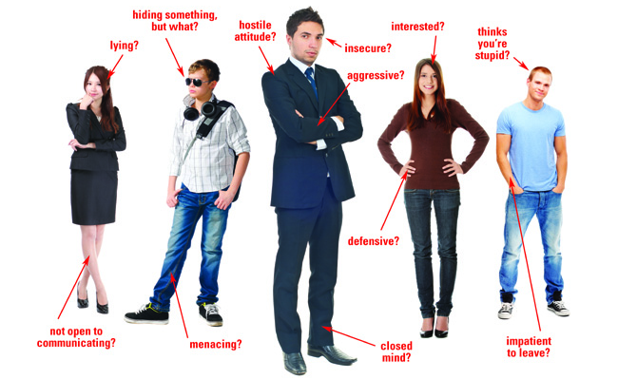
Intro to Body Language

Slide 16
Body Language Basics
80% - 90% of our communication is non-verbal. It is very important to be able to identify exactly what we are communicating to others non-verbally.
You may be trying to de-escalate the situation by talking to the other person, but your body language may be showing a willingness to get physical.
It is also important that we recognize and understand the non-verbal cues from another person who has the potential of escalating.

Slide 17
Body Language Basics
When people are angry, they sometimes do not “listen” to the words that are being said.
Remember the difference between “hearing” and “listening”.
Often, they do “see” and react to what you are “saying” with your body language.
You must always be very careful with the message you are sending!

Slide 18
Body Language: What Are You Saying?
Finger pointing may seem accusing or threatening.
Shoulder shrugging may seem uncaring or unknowing.
Rigid walking may seem unyielding or challenging.
Jaw set with clenched teeth shows you are not open-minded to listening to his/her side of the story.
A natural smile is good. A fake smile can aggravate the situation.
Use slow and deliberate movements – quick actions may surprise or scare the other person.

Slide 19
Body Language: Eyes
One eyebrow raised = “sternness”
Eyes open wide = “surprise”
A hard stare = ‘threatening gesture”
Closing eyes longer than normal = “I’m not listening” and/or “Change your message!” (This may be a warning that you are unintentionally escalating the situation!)

Slide 20
Body Language: Physical Stance
Recommendations:
Avoid turning your back to the client for any reason.
Try and be at the same eye level.
Allow extra physical space between you and the non-dominant side of client.
Do not maintain constant eye contact – this could be seen as threatening or aggressive. Allow client to break his/her gaze and look away.

Slide 21
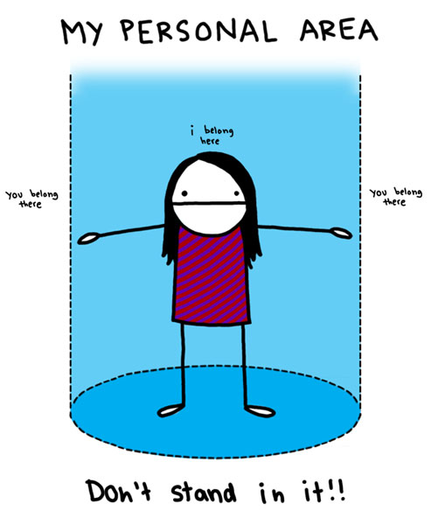
Body Language: Personal Space
Invasion or encroachment of personal space tends to heighten or escalate anxiety.
Note: Personal space is usually 1 ½ to 3 feet (Far enough away so you cannot be hit or kicked).
Do not touch a hostile person – they might interpret that as an aggressive action.
Keep your hands visible at all times – you do not want the other person to misinterpret your physical actions.

Slide 22
Reminders:
Again… Take a deep breath… This will calm you.
Listen – really listen!
Validate! “I understand why you might be upset.” (This does not indicate that you agree with them).
Avoid overreaction and do not become defensive – even if the comments or insults are directed at you.
Be aware of any resources available for backup – are there staff with skillsets that may help the situation?
Remove onlookers – or relocate to a safer place. (Onlookers can become either “cheerleaders” or additional victims). Send an onlooker for help.
Relocating makes it less likely that other clients will get involved or become an audience for the agitated client to play to. Let a coworker know where you will be.
Watch for non-verbal clues or threats.

Slide 23
The De-escalation discussion
Skills & Techniques

Slide 24
The De-escalation Discussion
Remember to limit the content of the interaction, focus should be on trying to calmly bring the level of agitation down to a safer place. Use simple, clear language.
Do not get loud or try to yell over a screaming person. Wait until he/she takes a breath…then talk.
Address the client by name, it helps to ground them.
Respond selectively: Answer only informational questions and educate, no matter how rudely asked (e.g. “Why do I have to fill out all these g-damn forms?”). DO NOT answer abusive questions (e.g. “Why are all the staff a--holes?”).

Slide 25
De-escalating Positively
Use positive and helpful statements such as:
“I want to help you!”
“Please tell me more so I better understand how to help you.”
“Let’s call Mr. Goins. I know he would be able to help with this.”
“Ms. Borsberry handles this for us, let’s ask her what she thinks about this situation. She is always willing to help!”
Put yourself on his/her side of finding a solution to the problem.

Slide 26
Being Firm, but Fair
Explain limits and rules in a firm, but always respectful tone.
Give choices where possible in which both alternatives are safe ones e.g. “Would you like to continue our meeting calmly or would you prefer to stop now and talk later, or come back tomorrow when things can be more relaxed.”
Empathize with feelings but not with the behavior e.g. “I understand that you have every right to feel angry, but it is not okay for you to threaten me or others.”

Slide 27
Firm, but Fair (cont)
Keep suggesting alternative behaviors when appropriate
e.g. “Would you like to take a break and have a cup of coffee [lukewarm in a paper cup] or some water?”
Give the consequences of inappropriate behavior without threats or anger.
Represent external controls (rules) as institutional rather than personal.

Slide 28
Avoid Power Struggles
Do not solicit how a person is feeling or interpret feelings in an analytic way. Instead talk about how you know the client wants to be in control; ask how you can help the client do this.
Do not argue or try to convince.
Wherever possible, tap into the client’s cognitive (thinking) mode:
DO NOT ask: “Tell me how you feel.”
INSTEAD ask:“Help me to understand what you are saying to me.”
NOTE: People are not attacking you or themselves while they are teaching you what they want you to know.

Slide 29
The Strength Within
Trust your instincts! If you assess or feel that de-escalation is not working… STOP! Tell the person to leave, escort him/her to the door, call for help or leave yourself and call police.
There is nothing magical about talking someone down. You are transferring your sense of calm, respectfulness, clear limit setting to the agitated person in the hope that he/she actually wishes to respond positively to your respectful attention.

Slide 30
Things NOT to do!
Avoid becoming emotionally involved – control your emotions at all times.
Avoid engaging in power struggles.
Avoid becoming ridged in your process.
Avoid telling the other person that you “know how he or she feels.”
Avoid raising your voice, cussing, making threats, and giving ultimatums or demands.
Avoid aggressive language, including body language.
Do not attempt to intimidate a hostile person.

Slide 31
Physical Force
Use of physical force is NEVER permitted.
Physical force would only be used as a last resort to prevent injury to yourself or to another person.
Use of physical force usually results in someone (you?) getting hurt.

Slide 32
Nonphysical interventions
Intervening Between Two Individuals

Slide 33
Partner Up
If you are alone, seek help!
Intervening between two individual's should always be addressed by [at least] two staff members.
Coordination and communication are key components to successfully de-escalating aggressive conflict.

Slide 34
Be a Helper
Staff member(s) not directly involved in the de-escalation will play an important role as well.
Here are possible tasks YOU may play when responding to a dispute:
Calling 911 or other emergency response personnel
Moving objects out of the area that could be used as weapons or obstruct the active intervention.
Documenting the incident: time, place, who’s involved, steps taken to resolve, dialogue, etc.
Calming nearby patients/clients/consumers: these situations can be very distressing.
Traffic control – blocking off the area or managing vehicle traffic if the incident is outside.

Slide 35
Intervention Steps
Quickly analyze what is happening
Seek help if needed
Each staff will focus on one person separately.
Use verbal and nonverbal blending to calm each individual down.
Get the individuals to back away and engage with you (telling you what’s going on).
Direct each individual away from the area.
Use techniques for de-escalation and intervention outlined in this training.
Debrief with staff and management.
Document the incident.

Slide 36
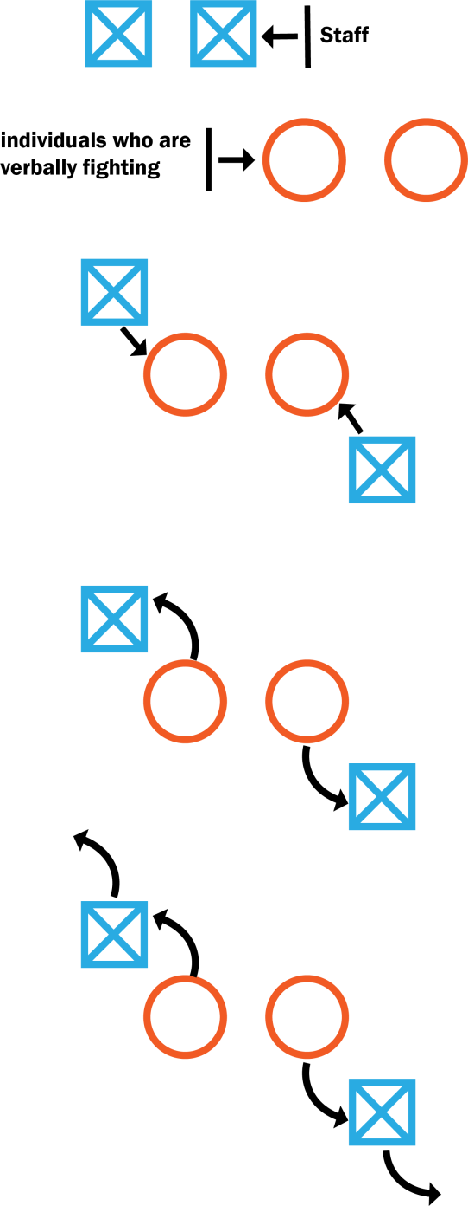
Intervention Illustrated
Coordinate Intervention. Communicate with other staff.
For safety, approach from behind and slightly to one side.
Each staff should focus on one person each, one on each side of the individuals if possible.
Get individuals to break eye contact.
Use non-physical techniques for de-escalation and intervention.
Direct individuals away from each other in opposite directions.

Slide 37
Notification and Follow-up
Always report minor situations.
Minor situations can be a “cry for help” and/or “warning signs” of bigger things to come!
Minor situations can lead to major situations.
After any confrontation, advise or direct the person to counseling or other supports, if possible.
Always document every threatening event.
Documentation will help all parties when evaluating re-occurring events.

Slide 38
Review
If you find yourself in a threatening situation, remember:
Listen. Hear the real “message” and repeat it back with “understanding”!
Empathize!
Be respectful when setting limits
Distract or divert the other person, if possible.
Try to re-focus him/her on something positive.
Motivate him/her to seek help.
Give choices.
Ask for help if needed.

